Slide 1

Shiny Deep Dive (02):
OAuth 2.0
Khaled Al-Shamaa, Associate Scientist - Biometrics
2nd CGIAR BA Team Hackathon, 13 Nov 2024

Slide 2
OAuth 2.0 Introduction
OAuth 2.0 is the industry-standard protocol for authorization (e.g., Google, Twitter, Facebook, GitHub, EBS, Scriptoria, etc.).
Designed to allow a website or application to access resources and data hosted by other web apps on behalf of a user (e.g., browser-based or server-side apps).
Protects user credentials by using tokens instead of usernames and passwords, reducing breach risks and complying with data protection laws (e.g., GDPR).
The OAuth 2.0 Authorization Framework (RFC 6749).

Slide 3
Authorization Code Flow
User (e.g., browser)
Client (e.g., Shiny app.)
OAuth2 Server (e.g., EBS)
1. Click “Login”
2. Redirect to /authorize
3. Prompt for login and consent
4. Enter credentials and consent
5. Redirect to client callback URL with code
6. Exchange code for token
7. Return access token
User
Client
OAuth2 Server

Slide 4


OAuth 2.0 using “httr2” Package
library(httr2)
authorize_url <- "https://auth.ebsproject.org/oauth2/authorize"
access_url <- "https://auth.ebsproject.org/oauth2/token"
client_secret <- "xxxxxxxxxxxxxxxxxxxxxxxxxxxxxxxxxxxxxxxxxxxxxxxxxxx"
client_id <- "xxxxxxxxxxxxxxxxxxxxxxxxx"
redirect_uri <- "http://localhost:1410"
EBS_client <- httr2::oauth_client(
id = client_id,
secret = client_secret,
token_url = access_url,
name = "EBS"
)
token <- httr2::oauth_flow_auth_code(
client = EBS_client,
auth_url = authorize_url,
redirect_uri = redirect_uri
)
str(token)
Notes:
QBMS::set_qbms_config(url = 'https://cbbrapi-wee.ebsproject.org', engine = 'ebs', brapi_ver = 'v2’)
QBMS::set_token(token$id_token, '', token$expires_at)
QBMS::list_programs()

Slide 5

library(shiny)
library(httr2)
EBS_client <- httr2::oauth_client(
id = client_id,
secret = client_secret,
token_url = access_url,
name = "EBS"
)
ui <- fluidPage(
actionButton("login", "Sign In"),
verbatimTextOutput("msg")
)
server <- function(input, output, session) {
observeEvent(input$login, {
token <- httr2::oauth_flow_auth_code(
client = EBS_client,
auth_url = authorize_url,
redirect_uri = redirect_uri
)
output$msg <- renderText(token$access_token)
})
}
shinyApp(ui, server, options = list(launch.browser = TRUE))
OAuth 2.0 and Shiny app.

Slide 6
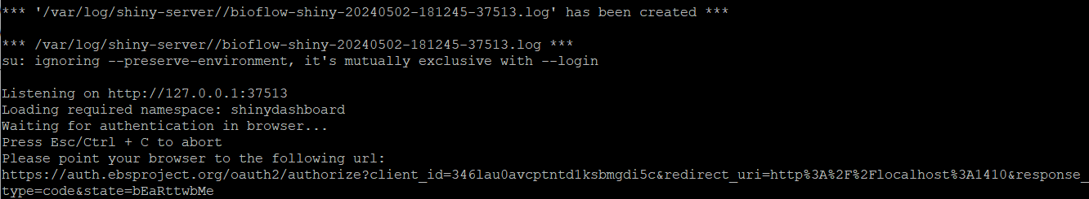
OAuth 2.0 & Cloud-Hosted Shiny apps!
In the desktop environment, the httr2 will open a browser window (interactively) where the user can grant access to the third-party app. Interestingly, httr2 starts a temporary web server using “httpuv” R package to listen for the OAuth redirect (http://localhost:1410/) when the server sends the access token and gets it.
# NOTE 01: check if we run it on localhost! is_local <- Sys.getenv("SHINY_PORT") == ""

Slide 7

Generate low-level/custom auth_url
ui <- fluidPage(
tags$script('Shiny.addCustomMessageHandler("redirect", # NOTE 03: define JS function
function(url) {window.location.href = (url)})’), # to call from shiny server
...
)
server <- function(input, output, session) {
observeEvent(input$login, {
oauth_state <- httr2:::base64_url_rand() # random to verify the request we created
auth_url <- httr2::oauth_flow_auth_code_url( # NOTE 02: low-level function to
client = EBS_client, # assemble a custom flow for API
auth_url = authorize_url, #
redirect_uri = redirect_uri, # generate the url that should be
state = oauth_state # opened in a browser
)
output$msg <- renderText(auth_url)
session$sendCustomMessage("redirect", auth_url) # NOTE 04: call JS redirect function
})
}
shinyApp(ui, server, options = list(port = 1410, launch.browser = TRUE)) # use port 1410
Sending and receiving messages from Shiny to JavaScript and back (Reference).

Slide 8

HTTP Cookies Introduction
HTTP cookie is a small piece of data (limited up to 4K) sent by a server to a browser and stored on the user’s computer while the user is browsing.
During OAuth 2.0, the user is redirected to a third-party login service (leaving Shiny app). HTTP is stateless protocol; cookies permit us to track the auth_state between different browser tabs/sessions.
Important Note: By default, the cookie is only available to the domain that set it (http://127.0.0.1 vs. http://localhost).
PHPSESSID=u4k9uvteelstrq6upr2c0jvtc9; pkce_verifier=2v547xm58sWj9WFWDJc0VL1E9uco 58f2bjKJpvRpPfY; oauth_state=bYPFf5qBn__giy1-BfAVlSkRmos9cZd61M6MPyUJu0U

Slide 9
set_cookie <- function(session, name, value){
...
}
ui <- fluidPage(
...
tags$script('$(document).on("shiny:connected",
function() {Shiny.setInputValue("cookies", document.cookie)});'),
)
server <- function(input, output, session) {
observeEvent(input$login, {
...
set_cookie(session, "oauth_state", oauth_state) # NOTE 05: set_cookie()
...
})
observeEvent(input$cookies, {
observeEvent(session$clientData$url_search, {
oauth_state <- sub(".*oauth_state=([^;]*).*", "\\1", input$cookies)
oauth_state <- sub(".*oauth_state=([^;]*).*", "\\1", session$request$HTTP_COOKIE)
output$msg <- renderText(oauth_state)
})
}
Shiny and Cookies
NOTE 08: Communicating with Shiny via JavaScript (Reference).
Trigger once HTML page fully loaded
NOTE 06: Trigger once URL changed
NOTE 07: Regular Expression to get the oauth_state cookie value

Slide 10
Get Access Token
server <- function(input, output, session) {
observeEvent(input$login, {
...
})
observeEvent(input$cookies, {
...
output$msg <- renderText(oauth_state)
query <- parseQueryString(session$clientData$url_search)
if (!is.null(query$code) && !is.null(query$state)) {
code <- httr2:::oauth_flow_auth_code_parse(query, oauth_state)
token <- httr2:::oauth_client_get_token(client = EBS_client,
grant_type = "authorization_code",
code = query$code,
state = query$state,
redirect_uri = redirect_uri)
output$msg <- renderText(token$access_token)
}
})
}
NOTE 09: Parse URL GET Parameters: http://localhost:1410/?code=720bbe65-959b-4331-8f27-0cdc85111121&state=pnMDo_eNTuJyRMsa1LORBESAAjJmaEYxXuP1z9ZYutE
Verify / Match URL vs. Cookie oauth_state value
NOTE 10: Call the access_url endpoint (2nd API call) to exchange the authorization code for access token

Slide 11

Proof Key for Code Exchange (PKCE)
server <- function(input, output, session) {
observeEvent(input$login, {
pkce <- httr2::oauth_flow_auth_code_pkce()
set_cookie(session, "pkce_verifier", pkce$verifier)
...
auth_url <- httr2::oauth_flow_auth_code_url(
...
auth_params = list(
scope = "openid profile",
code_challenge = pkce$challenge,
code_challenge_method = pkce$method
)
)
...
})
observeEvent(input$cookies, {
pkce_verifier <- sub(".*pkce_verifier=([^;]*).*", "\\1", input$cookies)
...
token <- httr2:::oauth_client_get_token(..., code_verifier = pkce_verifier)
...
})
}
NOTE 11: PKCE is an extension to the Authorization Code flow to prevent authorization code injection attacks (RFC 7636).

Slide 12

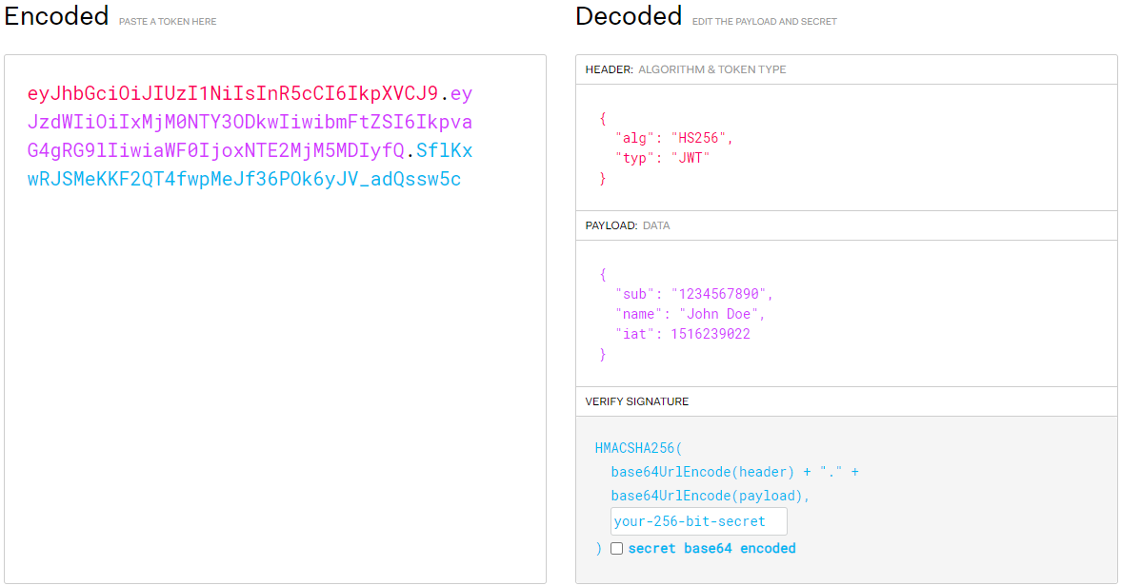
JSON Web Token (JWT)
https://jwt.io/
jwt <- strsplit(token$access_token, ".", fixed = TRUE)
# NOTE 12: checkpoint to interrupt Shiny app execution
browser()
# NOTE 13: decode and extract JWT payload
payload <- jsonlite::base64url_dec(jwt[[1]][2]) |>
rawToChar() |>
jsonlite::fromJSON()
output$msg <- renderText(payload$email)

Slide 13


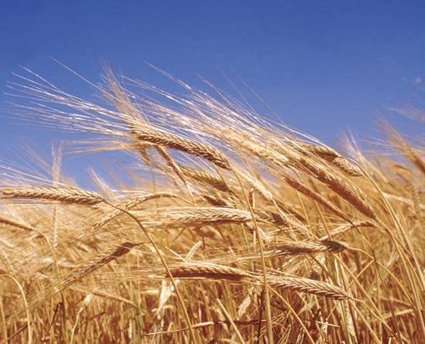
Thank You
Questions?

